Slide 1
Circular Flow in Four-sector Economy

Slide 2
Circular Flow in a Four-sector Economy
Besides households, firms, and the government, the foreign sector also plays a crucial role in an economy. Therefore, the circular flow in a four-sector economy consists of households, firms, government, and the foreign sector. Money flows in each of these sectors are as follows:

Slide 3
1. Household Sector:
The household sector of an economy provides factor services to the firms, government, and the foreign sector for which it received factor payments in return. Besides factor payments, the households also receive transfer payments like old age pensions, scholarships, etc., from the government and foreign sector. The household sector spends its earned income on Payments for goods and services purchased from firms, payments for imports, and tax payments to the government.

Slide 4
2. Firms:
The firms receive revenue for the sale of goods and services from the government, households, and foreign sectors. They also receive subsidies from the government to produce goods and services. Besides, the firms make payments for taxes to the government, factor services to the households, and imports to the foreign sector.

Slide 5
3. Government:
The government receives revenue for the sale of goods and services, fees, taxes, etc., from the firms, households, and the foreign sector. It also makes factor payments to households and spends its revenue on transfer payments and subsidies.

Slide 6
4. Foreign Sector:
The foreign sector receives revenue for the export of goods and services from firms, households, and the government. It also makes payments to firms and the government for the import of goods and services, and households for the factor services.

Slide 7
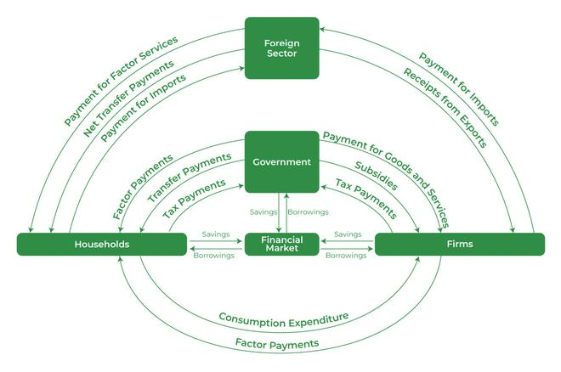
This concept can be better understood with the help of the following diagram:

Slide 8
THANK YOU

